Slide 1
Autoencoders: Machine Learning Final Project
COSC-A406-001
June Fernandez

Slide 2
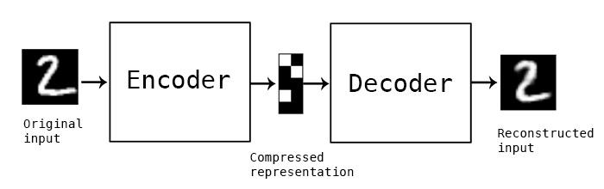
What are Autoencoders?
"Autoencoding" is a data compression algorithm where the compression and decompression functions are 1) data-specific, 2) lossy, and 3) learned automatically from examples rather than engineered by a human. Additionally, in almost all contexts where the term "autoencoder" is used, the compression and decompression functions are implemented with neural networks.
https://blog.keras.io/building-autoencoders-in-keras.html

Slide 3
What are Autoencoders Good For?
Autoencoders are not good at data compression, mainly due to them being data specific.
Two modern day uses of Autoencoders are data denoising and dimensionality reduction for data visualization
Sci-kit learn has a simple and practical implementation.
Autoencoders are a great introductory machine learning algorithm.
Many believe that autoencoders solve the problem of unsupervised learning
Autoencoders are considered a self-supervised learning algorithm, meaning they are not truly unsupervised.

Slide 4
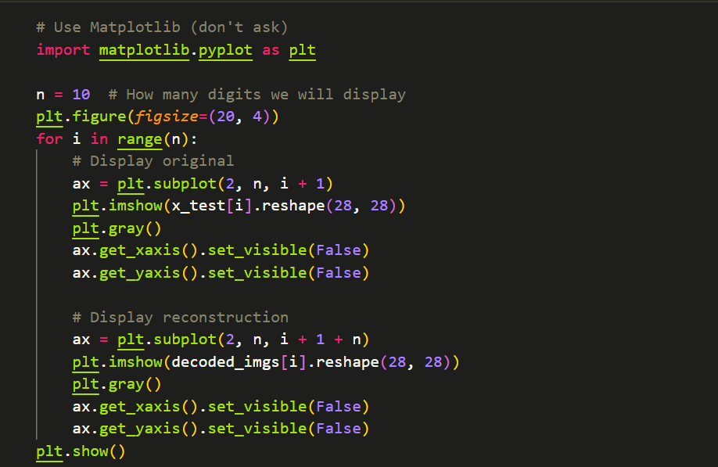
Here is some of the code for a basic autoencoder. After we create our encoder and decoder and train our model for 50 epochs, we display the output using matplotlib

Slide 5
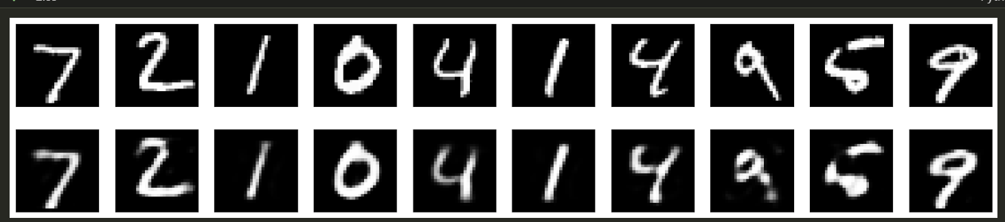
Here is the output of our simple autoencoder. Certain Autoencoders, like Convolutional Autoencoders, can create an even more cleaner recreation.

Slide 6
Autoencoders have multiple variants and versions, utilizing different layers and elements.

Slide 7
Variations of Autoencoders
Deep Encoder
Regularizer
Convolutional Autoencoder
Variational Autoencoder

Slide 8
Image Denoising
With Image Denoising, noisy digits are created, and our autoencoder is able to recover the original digits.
The training of this data takes a longer time, but the autoencoder is able to create the clear digits from the original data.
Image Denoising can occur with convolutional autoencoders.

